Slide 1
Battle of the Neighbourhoods
Scotland

Slide 2
Introduction
The Problem
Analyse data fromFoursquare data to compare the amenities available in Scotlands towns and villages
Compare them to the amenities available in the cities
Cluster the towns based on which city they are most similar too.
Target Audience
Relevant for anyone wishing to escape the cities for a quieter life in a smaller town while still enjoying similar amenities to what they are used to

Slide 3
The Data
Extract the Foursquare venue data for the 6 cities in Scotland and build up a profile for each city
Dundee
Edinburgh
Glasgow
Inverness
Perth
Stirling
Create similar profiles for the towns in Scotland with a population over 15000
The towns will be assigned to clusters based on their similarities to the cities.
This can then be plotted on a Folium Map to show the distribution of the clusters across Scotland.

Slide 4
Methodology
The locality names, status and population were taken from Wikipedia
The latitude and longitude data was gathered from openstreetmap.org.
The venue data was extracted from Foursquare.
The venue data was then combined based on the venue type into 11 broader categories
Locality, Restaurants, Bars, Entertainment, Culture, Shops, Transport, Sports, Nature, Accomodation, and Landmark
The dataframe was then divided into Cities and Towns, and a K Nearest Neighbour model was then created and trained on the City data.
This model was then used to assign the towns to a cluster based on their similarity to a City.
These points were then plotted on a Folium map.

Slide 5
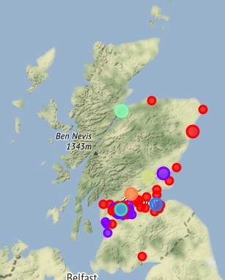
Results
The 45 towns were only assigned to two of the six groups, Aberdeen and Dundee.
When plotted on a map these showed more of the localities on the west coast were in the Dundee group, and localities on the east coast were in the Aberdeen group

Slide 6
Discussion
The low distribution of the localities between the groups is likely due to the cities being significantly more diverse than the towns.
The project may yield more useful results if the analysis was based on individual factors rather than looking at all 11 categories together.

Slide 7
Conclusion
The conclusions drawn from this project are project are unclear and it would likely have yielded better results if I was to have looked at it the other way around, identifying which city was most like a town rather than the towns being like cities.

